Slide 1

Customer Shopping Behavior Analysis
This project analyzes 3,900 customer purchases to uncover insights into spending patterns, customer segments, product preferences, and subscription behavior. Our goal is to guide strategic business decisions through data-driven recommendations.

Slide 2

Project Overview & Dataset Summary
Project Goals
Dataset at a Glance
Uncover spending patterns
Identify customer segments
Understand product preferences
Analyze subscription behavior
Guide strategic decisions
Rows: 3,900
Columns: 18
Key Features: Demographics, Purchase Details, Shopping Behavior
Missing Data: 37 values in Review Rating

Slide 3
Exploratory Data Analysis with Python
Data Loading & Exploration
Missing Data Handling
Column Standardization
Imputed missing values in 'Review Rating' using the median rating per product category.
Renamed columns to snake_case for improved readability and documentation.
Imported dataset using pandas and used df.info() and .describe() for initial structure and summary statistics.
Feature Engineering
Data Consistency & Integration
Created age_group by binning ages and purchase_frequency_days from purchase data.
Dropped redundant promo_code_used and loaded cleaned data into PostgreSQL for SQL analysis.

Slide 4
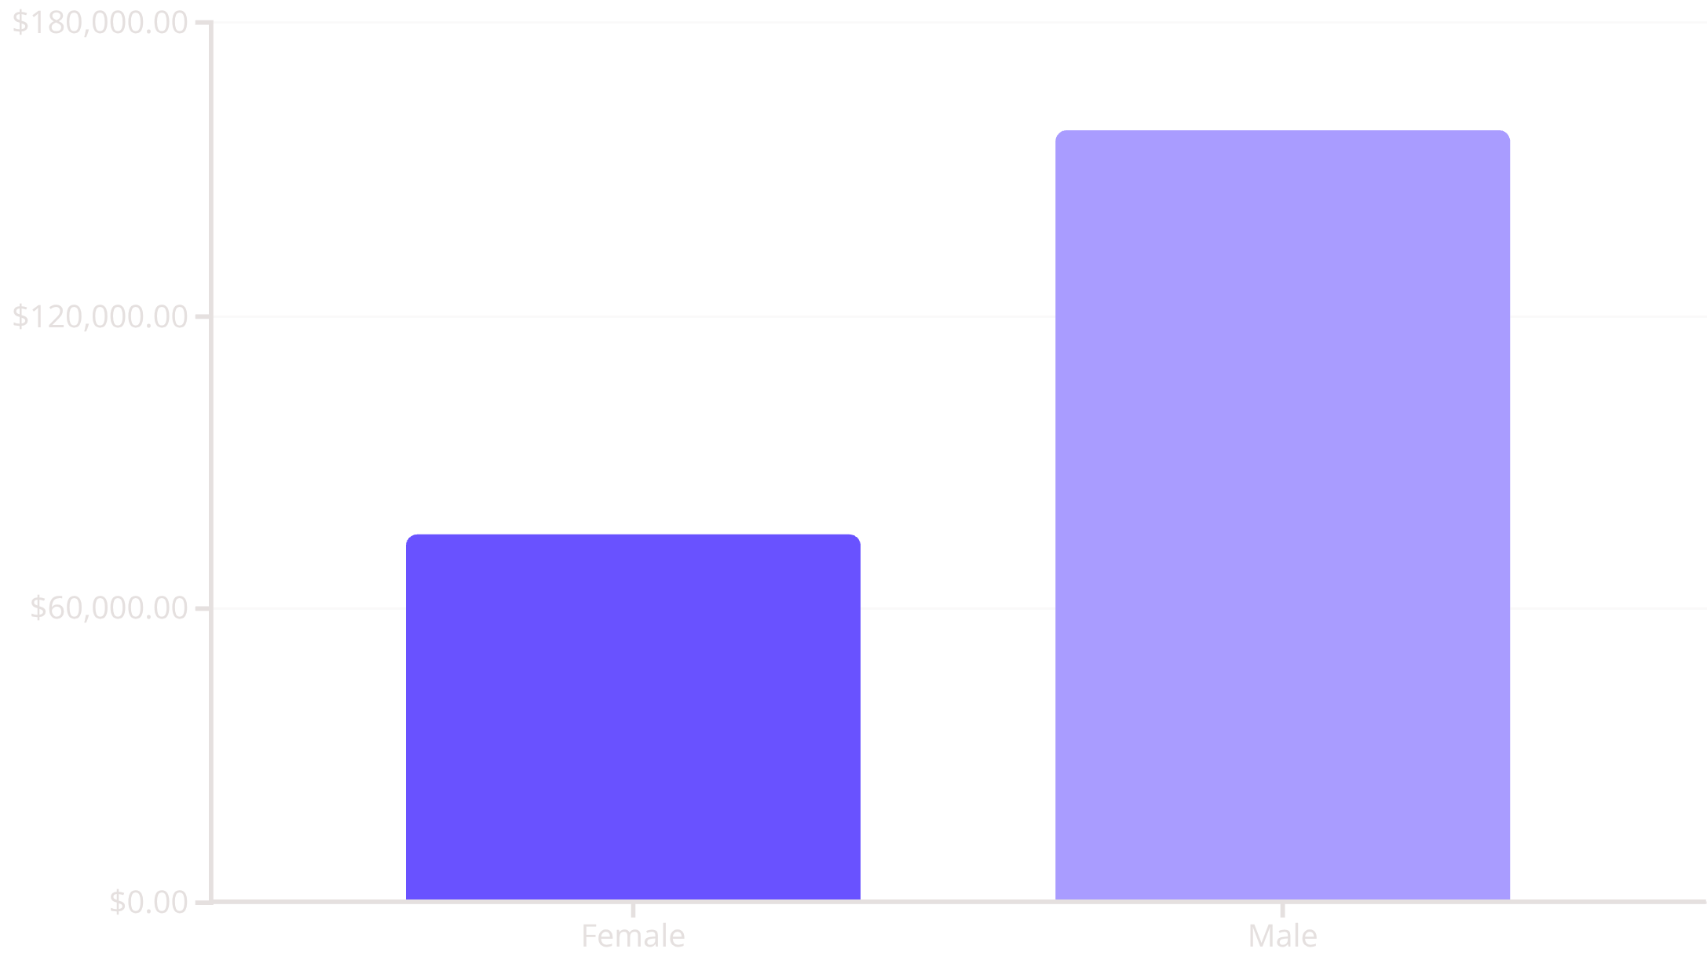
Revenue Insights by Gender
Male Customers Drive Higher Revenue
Our analysis reveals a significant difference in revenue contribution between genders. Male customers generated more than double the revenue compared to female customers.
This insight suggests potential opportunities for targeted marketing strategies or product offerings tailored to each gender segment.

Slide 5

High-Spending Discount Users
We identified 839 customers who utilized discounts yet maintained purchase amounts above the average. These customers represent a valuable segment that responds to promotions but still contributes significantly to revenue.
839 Customers
Above Average Spend
Used discounts
High purchase amounts
Valuable Segment
Respond to promotions

Slide 6
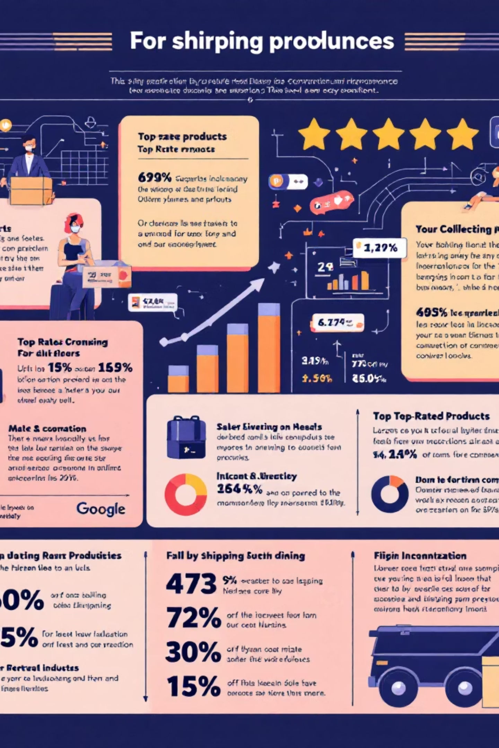
Product Performance & Shipping Insights
Top 5 Products by Rating
Shipping Type Comparison
Gloves: 3.86
Sandals: 3.84
Boots: 3.82
Hat: 3.80
Skirt: 3.78
Standard Shipping: $58.46 (Avg. Purchase)
Express Shipping: $60.48 (Avg. Purchase)
Customers using Express shipping tend to have slightly higher average purchase amounts.
These products consistently receive high customer satisfaction.

Slide 7
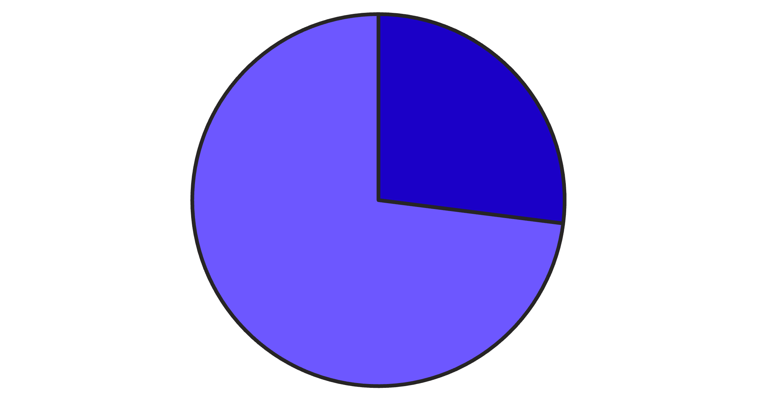
Subscription Status & Discount Dependency
Discount-Dependent Products
Hat: 50.00% discounted purchases
Sneakers: 49.66% discounted purchases
Coat: 49.07% discounted purchases
Sweater: 48.17% discounted purchases
Pants: 47.37% discounted purchases
Yes
No
These products frequently rely on discounts for sales.
Only 27% of customers are subscribers.

Slide 8


Customer Segmentation & Loyalty
Loyal Customers
New Customers
3,116 customers
83 customers
Returning Customers
701 customers
Our segmentation shows a strong base of loyal customers. Additionally, repeat buyers (those with >5 purchases) are more likely to subscribe, with 958 subscribers among them.

Slide 9

Top Products per Category & Age Group Revenue
Top 3 Products by Category
Revenue by Age Group
Accessories: Jewelry, Sunglasses, Belt
Clothing: Blouse, Pants, Shirt
Footwear: Sandals, Shoes, Sneakers
Outerwear: Jacket, Coat
Young Adult: $62,143
Middle-aged: $59,197
Adult: $55,978
Senior: $55,763
Young adults contribute the most revenue.

Slide 10





Key Business Recommendations
Boost Subscriptions
Promote exclusive benefits to increase subscriber base.
Customer Loyalty Programs
Reward repeat buyers to foster loyalty.
Review Discount Policy
Balance sales boosts with margin control for discount-dependent products.
Targeted Marketing
Focus campaigns on high-revenue age groups and express-shipping users.

